Slide 1

MACHINE LEARNING IN HEALTH MONITORING SYSTEM(HEART)
DEPARTMENT OF COMPUTER SCIENCE AND ENGINEERING
Guided By
DR. ARINDAM GIRI
Presented By
JOY CHAKRABORTY (00119191)
KUNAL GUPTA (00119065)
ROHIT DAS (00119114)
RITAM MALLICK (00119110)

Slide 2
Abstract
Heart disease is one of the most significant causes of mortality in the world today. Prediction of cardiovascular disease is a critical challenge in the area of clinical data analysis. Health monitoring is repeatedly mentioned as one of the main application areas. Machine learning algorithms use historical data as input to predict new output values. In this project, we propose a novel method that aims at finding significant features by applying machine learning techniques resulting in improving the accuracy in the monitoring of heart disease.

Slide 3
Literature Review
In disease detection an ai based application system especially the cardiac disease system detection improves the performance of other existing widely used models like models provided by American College of Cardiology/American Heart Association (ACC/AHA) models in CVD detection and prediction.[1]
Developing a Decision Support System in heart disease detection that uses the data mining technique having best accuracy and performance among Naïve Bayes, Support Vector Machine, Simple Logistic Regression, Random Forest & Artificial Neural Network (ANN) etc. By using several cardiovascular system parameters such as age, blood pressure, ECG results, sex, and blood sugar, it is possible to measure the possibility of getting affected by heart disease [2].
Monitoring of elderly patients from indoor or outdoor locations had been presented by a mobile health system in real time. A signal sensor and a smartphone were the primary components of the system.[3]

Slide 4
Literature Review
Wireless Health Monitoring System (WHMS) has attracted considerable attention from the research community and industry over the last decade. Improvement of several Machine learning algorithms and classifier performances like weighted associative classifier were reported in the detection of cardiac abnormalities [4].
In Prajakta Ghadge et al researched an intelligent heart attack prediction system using big data. Heart attack needs to be diagnosed timely and effectively because of its high prevalence. [5]

Slide 5
System requirements
Hardware requirements:
Processor: Any Updated Processor
Ram: Min 4GB Hard
Disk: Min 50GB
Software Requirements:
Operating System: Windows 8/8.1/10/11
Technology: Python 3.9+
IDE : Jupyter notebook
Complier: Visual Studio Code

Slide 6
What is machine learning ?
Machine learning is a branch of artificial intelligence that enables computers to learn and make predictions or decisions without being explicitly programmed. It involves the development of algorithms that learn from and analyze large amounts of data to identify patterns and make accurate predictions. The ultimate goal of machine learning is to enable machines to improve their performance over time through experience and data analysis.

Slide 7
Why machine learning for health monitoring system?
Machine learning algorithms can analyze large amounts of heart-related data and identify patterns and trends, enabling accurate predictions of heart conditions, such as arrhythmias or cardiac arrests.
By continuously monitoring data, machine learning models can detect subtle changes in patterns, enabling early detection of potential health issues and timely interventions.
Machine learning algorithms can analyze individual health data, including vital signs, medical history, and lifestyle factors, to create personalized care plans and recommendations tailored to the specific needs of each individual.
Machine learning algorithms can process data in real-time, allowing for continuous monitoring of heart health, immediate alerts for emergencies, and timely medical assistance.

Slide 8
Algorithms
NAIVE BAYES ALGORITHM : is a probabilistic classification algorithm that assumes independence between features, making it computationally efficient and easy to implement for large datasets. It calculates the probability of a given instance belonging to a particular class based on the probability distribution of its features.
LOGISTIC REGRESSION ALGORITHM : Logistic Regression is a statistical algorithm used for binary classification tasks. It models the relationship between the input features and the probability of belonging to a certain class using a logistic function, allowing for efficient and interpretable predictions.
K-NEAREST NEIGHBORS ALGORITHMS: The k-Nearest Neighbors (k-NN) algorithm is a non-parametric classification algorithm that assigns a class label to a data point based on the majority vote of its k nearest neighbors in the feature space.
SUPPORT VECTOR MACHINE: It is a powerful supervised learning algorithm used for classification and regression tasks. It finds an optimal hyperplane that maximally separates different classes or fits a regression line while minimizing the classification error or regression error, respectively.

Slide 9
Algorithms
RANDOM FOREST ALGORITHM: It is an ensemble learning algorithm that combines multiple decision trees to make predictions. It reduces overfitting and improves accuracy by aggregating the predictions of individual trees, resulting in a robust and versatile algorithm for classification and regression tasks.
DECISION TREE ALGORITHM: It is a simple yet powerful machine learning algorithm that uses a tree-like model to make decisions based on features. It recursively splits data based on attribute values and creates a tree structure that can be used for classification or regression tasks.
Extreme Gradient Boost (XGBoost) ALGORITHM: XGBoost is a powerful algorithm that improves predictions by combining many weak models together. It's great for tasks like classification and regression because it's efficient and produces accurate results.

Slide 10
Implementation Overview
1. Data Collection: Gather data from various sources.
2. Data Preprocessing: Clean and preprocess the collected data, including handling missing values, normalizing features, and removing noise or outliers after that analyze data.
3. Feature Engineering: Extract relevant features from the data that are indicative of the health condition being monitored, considering factors like heart rate, blood pressure, or oxygen levels.
4. Model Training: Utilize machine learning algorithms to train predictive models using the preprocessed data.
5. Deployment : Deploy the trained models in a system to analyze real-time data, make predictions, and provide alerts or recommendations for healthcare professionals or patients based on the monitored parameters.

Slide 11
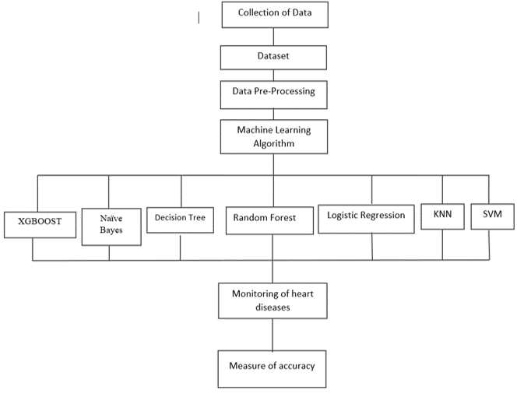
System Dataflow

Slide 12

Dataset and it’s attributes
age: (int) - Age in years
sex: (int) - (1 = Male, 0 = Female)
cp: (int) - Chest pain type(0 = Typical Angina ,1 = Atypical Angina,2 = Non-anginal Pain,3 = Asymtomatic)
trestbps: (int) - Resting Blood Pressure (in mm Hg on Admission to the Hospital)
chol: (int) - Serum cholesterol in mg/dl
fbs: (int) - Fasting blood sugar >120 mg/dl (1 = Greater than 120 mg/dl , 0 = Less than 120 mg/dl)
restecg: (int) - Resting electrocardiographic results
thalach: (int) - Maximum heart rate achieved
exang: (int) - Exercise induced angina (1 = yes, 0 = no)
oldpeak: (float) - ST depression induced by exercise relative to rest
slope: (int) - The slope of the peak exercise ST segment
ca: (int) - Number of major vessels (0-3)
thal: (int) - A blood disorder called thalassemia (1= Normal, 2 = Fixed Defect, 3 = Reversible Defect)

Slide 13
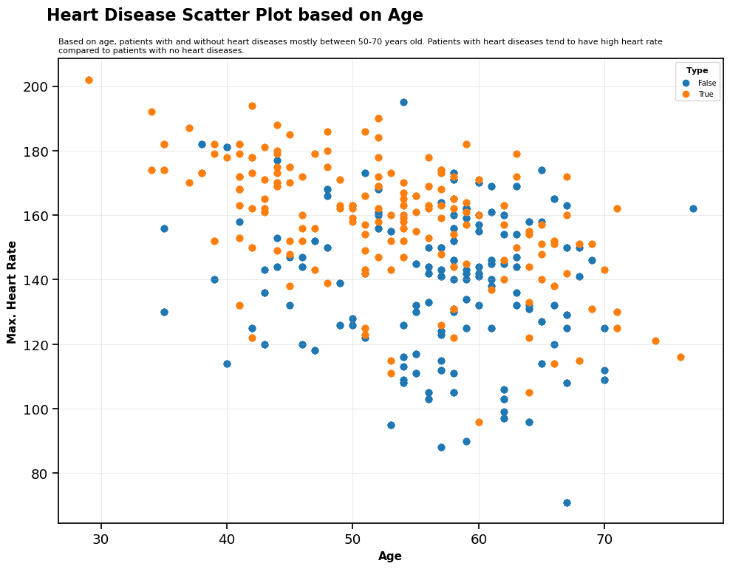
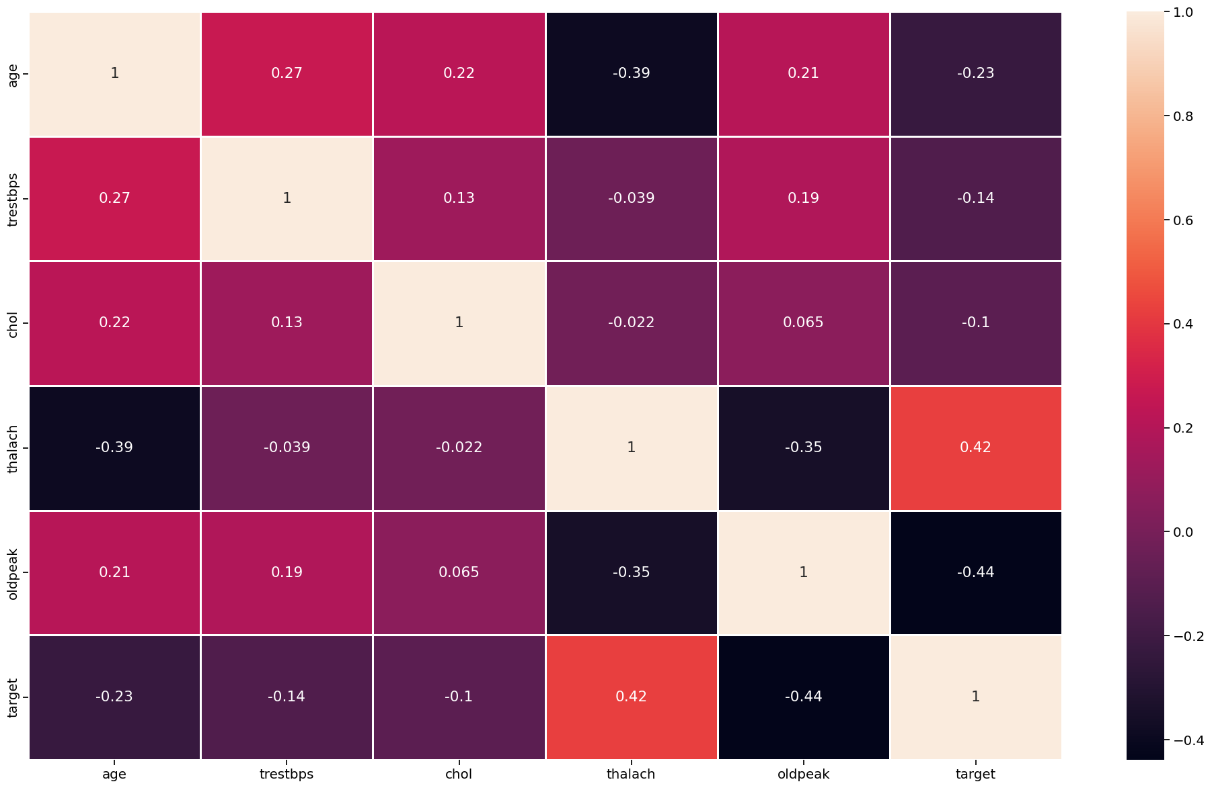
Data Analysis
Correlation matrix
Scatter Plot based on Age

Slide 14
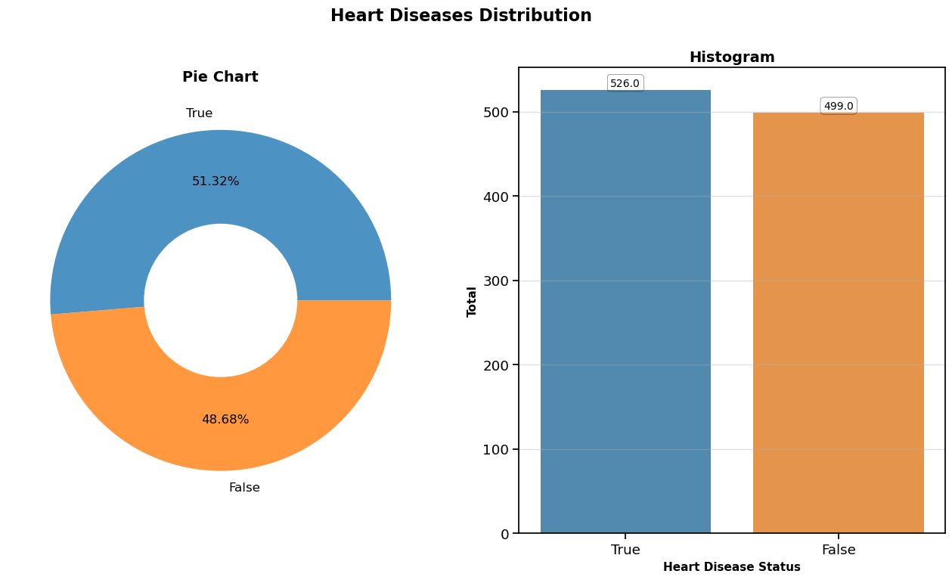
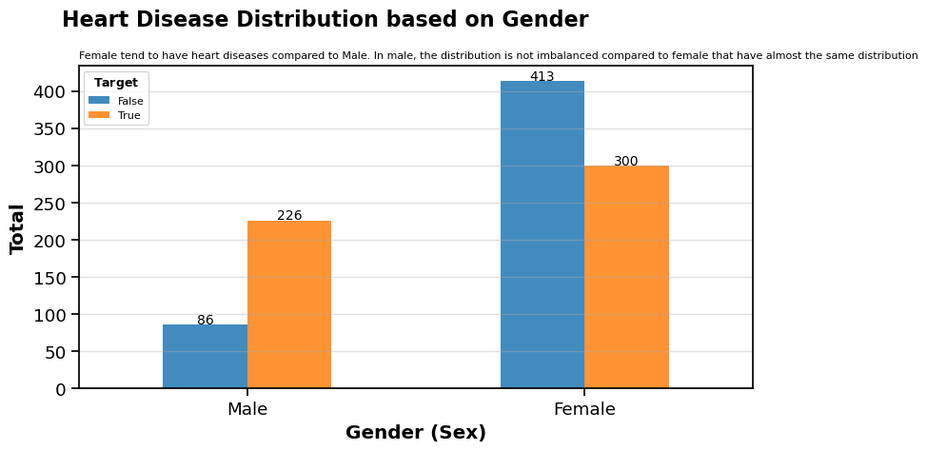
Barplot on Heart disease distribution based on Gender
Piechart and Histogram on heart diseases distribution

Slide 15
Result
After performing the machine learning approach for training and testing we find that accuracy of the Decision Tree is better compared to other algorithms.
Algorithm | Accuracy
Logistic Regression | 84.88%
Naive Bayes | 81.46%
Random Forest | 90.73%
Extreme Gradient Boost | 88.29%
K-Nearest Neighbour | 84.88%
Decision Tree | 92.19%
Support Vector Machine | 87.80%

Slide 16
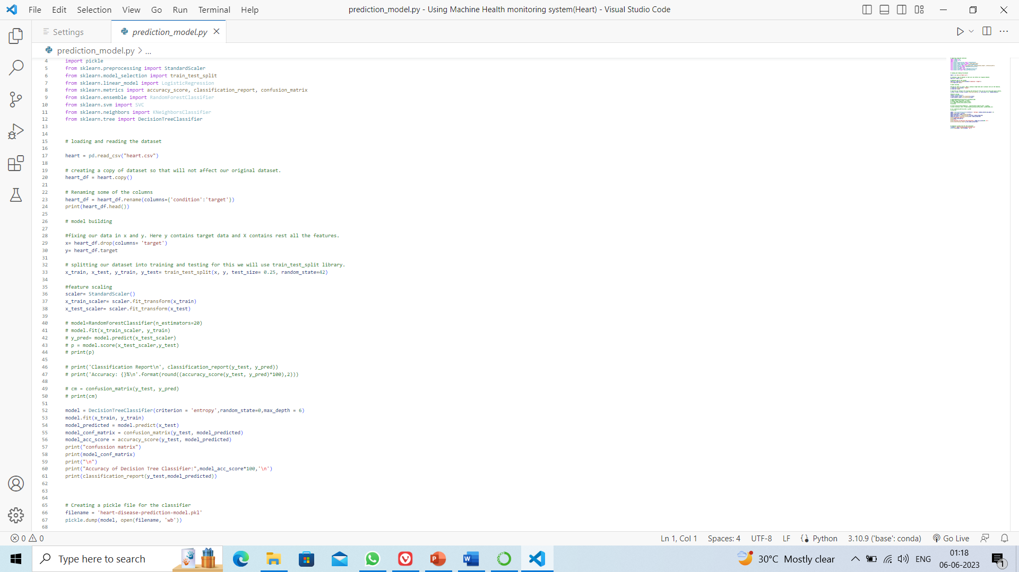
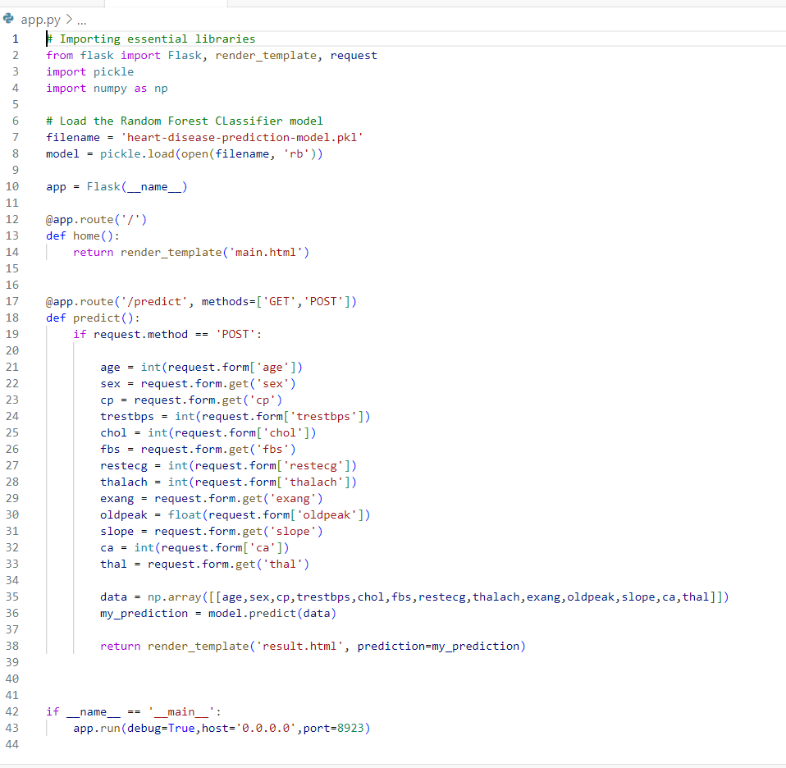
Snap Shots
Prediction model code
Flask code

Slide 17
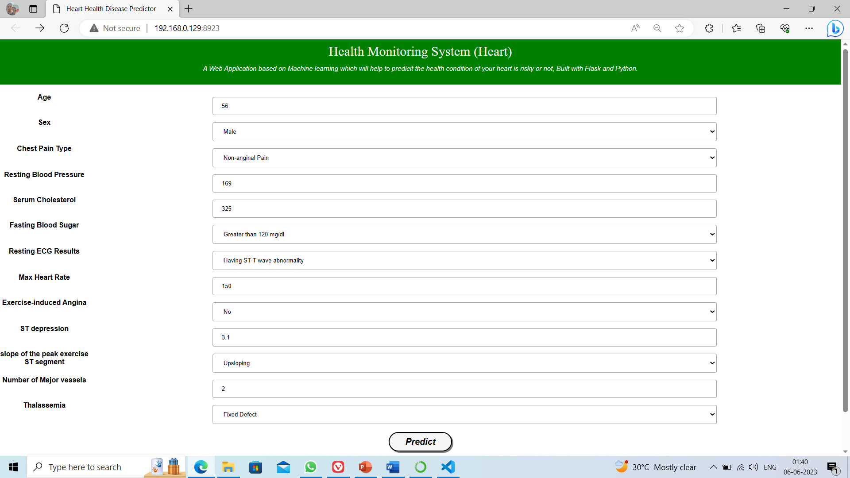
Web Application Snap Shots
INPUT(Main )

Slide 18
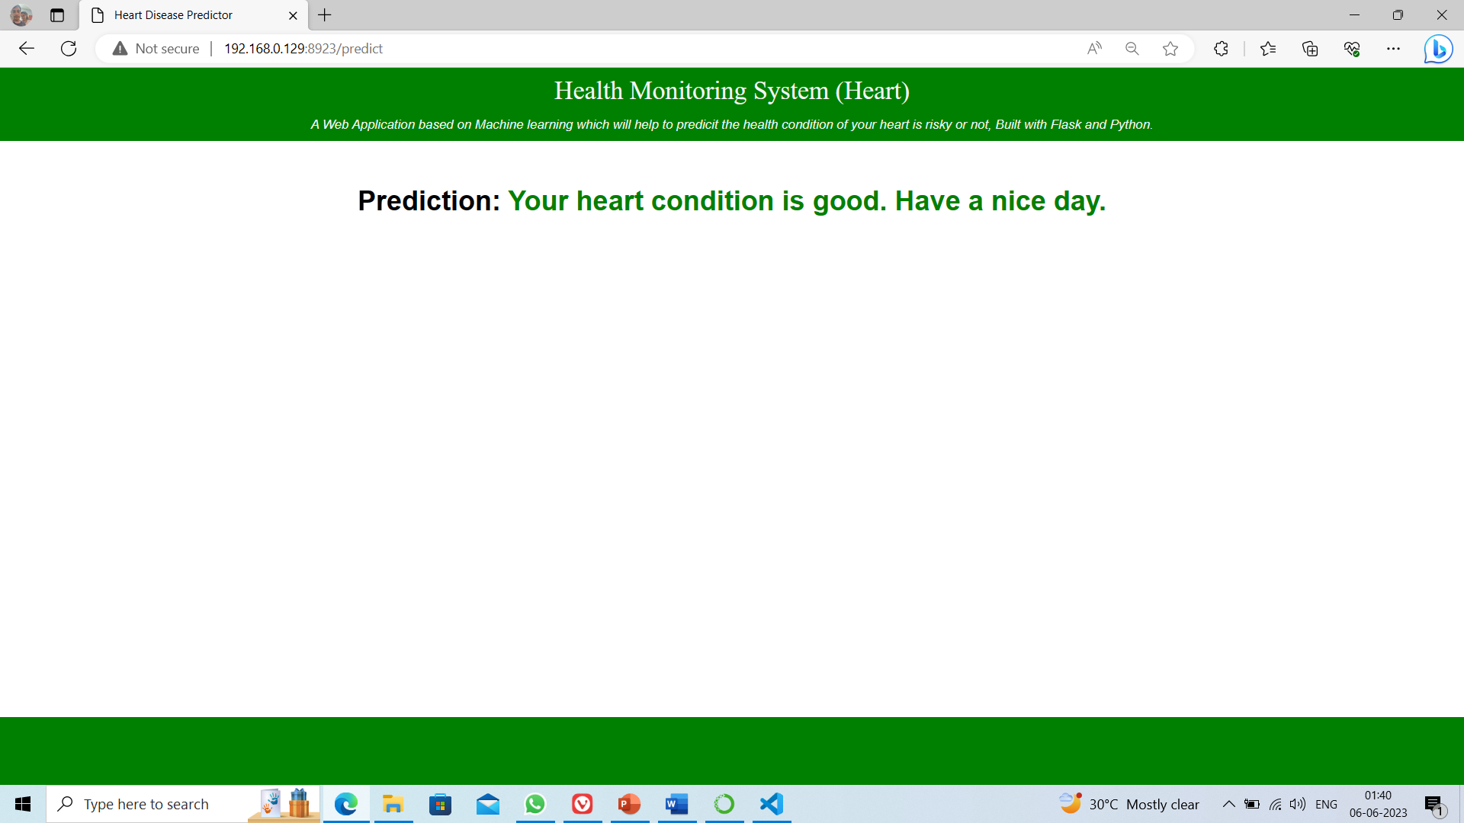
OUTPUT(Predicted result)

Slide 19
Future Scope
Machine learning has immense potential in health monitoring systems for heart disease. It can enable personalized risk assessment, real-time monitoring, early detection, integration with wearable devices, data fusion, explain ability, and continuous learning.
Some key areas where machine learning can make a significant impact:
Real-Time Monitoring
Early Detection and Prevention
Integration with Wearable Devices
Continuous Learning and Adaptability
Explainable AI and Interpretability

Slide 20
Conclusion
Machine learning plays a crucial role in the development of a health monitoring system for heart disease. The project involves data collection, preprocessing, feature engineering, model selection, and evaluation. The selected model is trained and validated on appropriate datasets, and its performance is assessed using suitable metrics. The deployment of the system requires careful consideration of ongoing monitoring. Machine learning in health monitoring systems has the potential to improve early detection, intervention, and management of heart disease, leading to better patient outcomes and healthcare efficiency.

Slide 21
Reference
1. Weng, S.F., Reps, J., Kai, J., Garibaldi, J.M. and Qureshi, N. (2017) Can Machine-Learning Improve Cardiovascular Risk Prediction Using Routine Clinical Data? PLoS ONE, 12, e0174944.
2. Shouman, M., Turner, T. and Stocker, R. (2012) Using Data Mining Techniques in Heart Disease Diagnosis and Treatment. Electronics, Communications, and Computers, Alexandria, 173-177.
3. havan Patil, A.B. and Sonawane, P. (2017) To Predict Heart Disease Risk and Medications Using Data Mining Techniques with an IoT Based Monitoring System for Post-Operative Heart Disease Patients. International Journal on Emerging Trends in Technology (IJETT), 4, 8274-8281.
4. Soni, J., Ansari, U. and Sharma, D. (2011) Intelligent and Effective Heart Disease Prediction System Using Weighted Associative Classifiers. International Journal on Computer Science and Engineering (IJCSE), 3, 2385-2392.
5. Ghadge, P., Girme, V., Kokane, K. and Deshmukh, P. (2016) Intelligent Heart Attack Prediction System Using Big Data. International Journal of Recent Research in Mathematics Computer Science and Information Technology, 2, 73-77.

